Slide 1
understanding teachers’ use of computer-based simulations in teaching electrolysis
By Dr. Nkhululeko L. Nxumalo
21st May 2019

Slide 2
Introduction
Kaheru and Kriek (2010) define computer based simulations (CBS) as simple computer programs capable of displacing or representing concepts, ideas or representations
A CBS is a program that is run on a computer to explore the approximate behaviour of the real system (Krain & Shadle, 2006)

Slide 3
Introduction cont…
CBS have the potential to enhance learners’ understanding of abstract concepts in science education (Jaakkola & Nurmi, 2008)
Trey and Khan (2008) argue that CBS enhances learning by enabling learners to visualise unobservable phenomena and may aid learners’ understanding of the sub-microscopic processes in electrolysis

Slide 4
Introduction cont…
In Eswatini, electrolysis is one of the abstract topics in which learner understanding is very poor
Electrolysis is a difficult topic for learners as well as for teachers (Rollnick & Mavhunga, 2014; Li Bong & Lee, 2016).

Slide 5
Factors that contribute to learners’ challenges
Learners have a challenge in identifying the anode and the cathode, with analysing the reaction in the electrolysis of molten compounds and the aqueous solutions and writing chemical equations

Slide 6
Factors that contribute to learners’ challenges
Language barrier
Rote learning
Teachers’ lack of subject matter
Learners then opt to memorise when teachers cannot explain effectively ( Taner, Osman & Sami, 2012)

Slide 7
Factors that contribute to learners’ challenges
It is expected that learners studying electrolysis must operate on three levels of thinking: the macroscopic, microscopic and the symbolic level (Mbajiorgu & Reid, 2006)
However, Halim, Ali, Yahaya & Haruzuan (2013) and de Jong & Taber (2014) note that learners have a challenge in operating at these three chemical representations levels because they cannot see a connection between these levels

Slide 8
Problem statement
It has been found that a large number of learners in eSwatini schools do not do science practicals because there is a shortage of science laboratories and equipment
Even in schools that do have laboratories, most are not functional (Nxumalo, 2014)
Nkemakolam, Chinelo and Jane, (2018) note that teachers do not do chemistry experiments because they claim that they can be hazardous

Slide 9
Problem statement
Nkemakolam, Chinelo and Jane (2018) argue that not doing experiments lead to poor performance in chemistry
In order to improve the performance of learners in Physical Science in eSwatini, different ways of learning rather than transmitting information need to be implemented

Slide 10
Research questions
Primary research question
How can teachers’ use of CBS in teaching electrolysis be understood?
Secondary research questions
What are teachers’ views on the use of CBS in teaching and learning electrolysis?
How do teachers integrate CBS into teaching electrolysis?

Slide 11
Conceptual framework for research
The way in which a teacher uses and integrates CBS into teaching can be regarded as a manifestation of his/her PCK

Slide 12
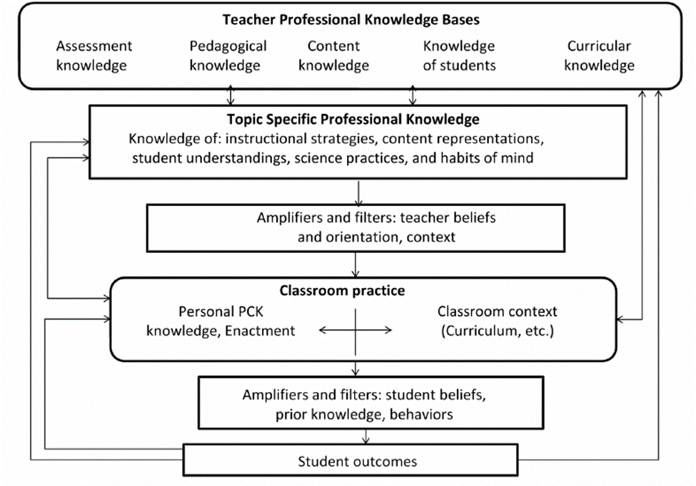
Conceptual framework for research

Slide 13
Methodology
The study is located within the interpretive paradigm to understand teachers’ use of CBS in teaching electrolysis
A qualitative case study research design was adopted.
The sampling procedure was purposive and convenient and three experienced chemistry teachers (who had not previously used CBS) from three different schools that had computer laboratories were selected as participants

Slide 14
Methodology cont…
Teachers’ profile
TEACHER | GENDER | TEACHER’S QUALIFICTIONS | CHEMISTRY TEACHING EXPERIENCE (Years) | LOCATION OF SCHOOL | NUMBER OF LEARNERS
A | Male | Bachelor of Science (B.Sc and Post graduate Certificate in Education (PGCE) | 24 | Manzini region in a semi-urban school | 44
B | Female | B.Sc and PGCE | 15 | Manzini region in a semi-urban school | 53
C | Female | B.Sc. with Education | 14 | Hhohho region in an urban area | 45

Slide 15
Methodology cont…
Three computer simulations were given to each participant to integrate into their teaching of electrolysis
Trustworthiness was enhanced by employing several data collection strategies: the observation of three lessons per teacher while teaching electrolysis; an analysis of lesson plans; as well as questionnaires and interviews before and after using CBS.

Slide 16
Methodology cont…
They were observed how they introduced their lessons
How they integrated the CBS in their lessons
If they referred learners to the CBS

Slide 17
Methodology cont…
One of the CBS demonstrated the change of mass and the migration of electrons and ions
The other CBS was on electrolysis of acidified water
The third CBS was on the electrolysis of brine
Content analysis was used to analyse data

Slide 18
Results
Six themes emerged from the data
Advantages of CBS
Learners’ difficulties in learning electrolysis
Challenges in using CBS
Teaching strategies
Teachers’ curricular knowledge
Teachers’ attitudes

Slide 19
Discussion of results
First sub-question was: What are teachers’ views on the use of CBS in teaching and learning electrolysis?
All three teachers believed that CBS enhances learning by enabling learners to visualise the sub microscopic processes, such as the movement of ions and electrons.
They also believed that using CBS captures learners’ interest and therefore enhance the understanding of the topic

Slide 20
Discussion of results cont…
All the teachers were concerned about shortage of equipment
Teacher A and B were also concerned about the large of learners
Teacher B and C also mentioned the socio-economic background as a challenge

Slide 21
Discussion of results cont…
Second sub-question: How do teachers integrate CBS into teaching electrolysis?
Teacher B and C allowed the learners to work on their own and manipulate the CBS because they understood that CBS should be used with a learner-centred approach

Slide 22
Discussion of results cont…
Both teacher B and C mentioned that the active involvement of learners in manipulating the CBS was crucial for learning
Teacher B and C utilised the CBS in each of the lesson observations, facilitating the various groups in class. Both conducted classroom discussions after the CBS, asking learners what they had observed.

Slide 23
Discussion of results cont…
Contrarily, teacher A used only one of the three CBSs that were provided. He did involve learners in a practical experiment, thereby engaging them with the macroscopic reality
However, he used the CBS after they had completed the experiment, but only during the first lesson and used it in isolation, that is, without referring to it during the lesson.
He believed that seeing the movement of ions during the first lesson would be sufficient to understand the process in the other applications of electrolysis.

Slide 24
Discussion of results cont…
Teacher A indicated that he would prefer a big screen with speakers, so that learners could see and hear, which indicates that he did not understand that manipulating the CBS enhances the understanding of sub-microscopic processes
While Teacher B and C believed that CBS improved learners’ understanding and the teacher was expected to lead discussing after learners had manipulated with them to reinforce learning

Slide 25
Discussion of results cont…
The main question was: How can teachers’ use of CBS in teaching electrolysis be understood?
Teacher A did not consider CBS as a method of teaching which should lead to learners’ manipulating or being hands-on with the topic
Teacher B and Teacher C had an understanding that using CBS required learners to manipulate the simulated apparatus in the CBS

Slide 26
Conclusion
It can be concluded that CBS should not be regarded as a panacea to overcome the challenges in teaching electrolysis, or to teach science altogether
The results indicate that a lack of pedagogical knowledge of the appropriate use of CBS may lead to its ineffective use, as pointed out previously by Rutten et al. (2012).

Slide 27
Conclusion cont…
To be used appropriately, learners have to manipulate the CBS, and teachers have to allow learners to work on their own but guide them by asking relevant questions in the form of discussions or questioning teaching methods
Teachers’ lack of content knowledge can seriously impede potential learning offered by CBS

Slide 28
Conclusion cont…
In particular, the teachers’ lack of content knowledge obstructed the opportunity to help learners make sense of the chemical reactions shown in the CBS
However, CBS may also help teachers to realise their own inadequate knowledge and it thus has long-term benefits. The teachers’ attitudes towards CBS acted as amplifiers and filters for their use of CBS

Slide 29
Conclusion cont…
Teachers in the various departments in schools work in isolation
Thus, the computers in these schools are underutilised
There is a need for schools to review their policies so as to allow teachers in the respective departments to have access to the computers to support learning in all subjects

Slide 30
Conclusion cont…
The results of this study concur with existing literature in that CBS enhance learners’ understanding of abstract concepts such as electrolysis (Kotoka & Kriek, 2014; Kindgren & Schwartz, 2009)
This study also shows that teachers’ PCK and SMK also has a great effect on whether CBS may or may not enhance learners’ understanding

Slide 31
Conclusion cont…
Teachers’ beliefs and use of CBS is very important in making CBS an effective teaching method
Teachers have to be oriented on the appropriate use of CBS so that CBS may be of great benefit to both teachers and learners
The results concur with Sarabando, Cravino and Soares (2014) who noted that learners’ gain depends on teachers’ pedagogy when using CBS when compared to when using experiments

Slide 32
Recommendations from study
There is need for introducing CBS in all schools
It is recommended that teachers be informed through educational workshops regarding the value of using CBS in their teaching so that they can embrace it
Also, it is recommended that the policies in schools be reviewed so as to maximise the accessibility of computers

Slide 33
Recommendations from study cont..
It is also recommended that teachers be informed that CBS cannot replace any of the teaching methods that they normally use, but rather these have to be combined with CBS
It is also recommended that teachers be guided on how much time they should spend using CBS in each topic so as to avoid losing track of time while using CBS

Slide 34
Thank you

